Slide 1
BI Testing
October 2015
This document is CitiusTech Confidential and contains proprietary information, including trade secrets of CitiusTech. Neither the document nor any of the information contained in it may be reproduced or disclosed to any unauthorized person under any circumstances without the express written permission of CitiusTech.

Slide 2
Contents
Business Intelligence overview
Business Intelligence workflow
Components of DWH
Meta-Data in DWH
Data warehouse Schemas
Introduction to BI Testing
BI Testing Approach
Introduction to ETL
ETL test processes and scenarios
Introduction to Reporting
Report Testing scenarios

Slide 3
What is Business Intelligence?
Business Intelligence overview (1/4)
Business intelligence (BI) is a broad category of applications and technologies for gathering, storing, analyzing, and providing access to data to help enterprise users make better business decisions.
BI applications include the activities of decision support systems, query and reporting, online analytical processing (OLAP), statistical analysis, forecasting, and data mining.

Slide 4
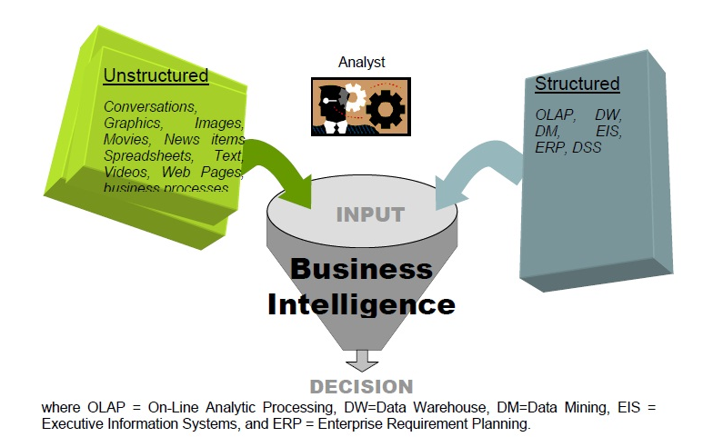
Business Intelligence overview (2/4)
Inputs To Business Intelligence
Input to BI Applications can be unstructured data like images, movie, text and structured like data from data mining, warehouse, etc. alongside the standard structured source systems
Notes:
Input to BI Applications can be unstructured data like images, movie, text and structured like data from data mining, warehouse, etc alongside the standard structured source systems

Slide 5
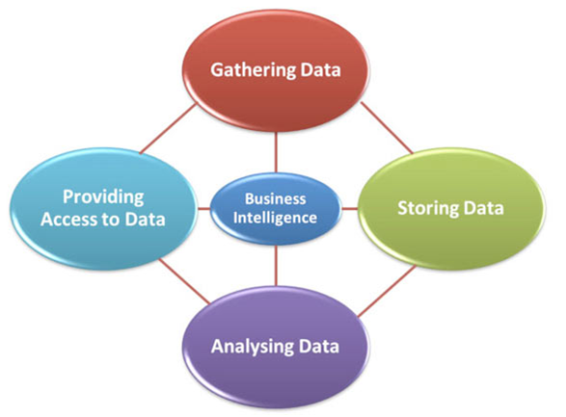
Basic Elements of BI (1/2)
Business Intelligence overview (3/4)
Gathering Data
Gathering data is concerned with collecting or accessing data .
Gathering data can be done in many formats. Like from transactional systems that keep logs of past transactions, production systems that measure and track quality, etc.
A major challenge of gathering data is making sure that the relevant data is collected in the right way at the right time. If the data quality is not controlled at the data gathering stage then it can jeopardize the entire BI efforts that might follow – always remember the old adage - garbage in garbage out.
Storing Data
Storing Data is concerned with making sure the data is filed and stored in appropriate ways.
Good data storage starts with the needs and requirements of the end users and a clear understanding of what they want to use the data for.
Notes:
Gathering data
Gathering data is concerned with collecting or accessing data .
Gathering data can be done in many formats. Like from transactional systems that keep logs of past transactions, production systems that measure and track quality, etc.
A major challenge of gathering data is making sure that the relevant data is collected in the right way at the right time. If the data quality is not controlled at the data gathering stage then it can jeopardize the entire BI efforts that might follow – always remember the old adage - garbage in garbage out.
Storing Data
Storing Data is concerned with making sure the data is filed and stored in appropriate ways.
Good data storage starts with the needs and requirements of the end users and a clear understanding of what they want to use the data for.
Analyzing Data
The next component of BI is analyzing the data. Here we take the data that has been gathered , inspect and transformed which will support our business decision making.
Analysis techniques includes the use of statistical tools, data mining approaches as well as visual analytics or even analysis of unstructured data such as text or pictures.
Providing Access
In order to support decision making the decision makers need to have access to the data.
The former is provided by the latest software tools that allow end-users to perform data analysis while the latter is provided through reporting, dashboard and scorecard applications.

Slide 6
Basic Elements of BI (2/2)
Business Intelligence overview (4/4)
Analyzing Data
The next component of BI is analyzing the data. Here we take the data that has been gathered , inspect and transformed which will support our business decision making.
Analysis techniques includes the use of statistical tools, data mining approaches as well as visual analytics or even analysis of unstructured data such as text or pictures.
Providing Access
In order to support decision making the decision makers need to have access to the data.
The former is provided by the latest software tools that allow end-users to perform data analysis while the latter is provided through reporting, dashboard and scorecard applications.
Notes:
Gathering data
Gathering data is concerned with collecting or accessing data .
Gathering data can be done in many formats. Like from transactional systems that keep logs of past transactions, production systems that measure and track quality, etc.
A major challenge of gathering data is making sure that the relevant data is collected in the right way at the right time. If the data quality is not controlled at the data gathering stage then it can jeopardize the entire BI efforts that might follow – always remember the old adage - garbage in garbage out.
Storing Data
Storing Data is concerned with making sure the data is filed and stored in appropriate ways.
Good data storage starts with the needs and requirements of the end users and a clear understanding of what they want to use the data for.
Analyzing Data
The next component of BI is analyzing the data. Here we take the data that has been gathered , inspect and transformed which will support our business decision making.
Analysis techniques includes the use of statistical tools, data mining approaches as well as visual analytics or even analysis of unstructured data such as text or pictures.
Providing Access
In order to support decision making the decision makers need to have access to the data.
The former is provided by the latest software tools that allow end-users to perform data analysis while the latter is provided through reporting, dashboard and scorecard applications.

Slide 7
Business Intelligence overview
Business Intelligence workflow
Components of DWH
Meta-Data in DWH
Data warehouse Schemas
Introduction to BI Testing
BI Testing Approach
Introduction to ETL
ETL test processes and scenarios
Introduction to Reporting
Report Testing scenarios

Slide 8
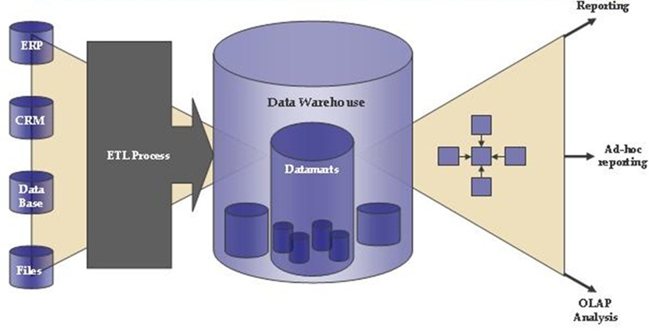
Business Intelligence Workflow(1/6)
In BI workflow, data is moved from databases used in operational systems into a data warehouse staging area, then into a data warehouse and finally into a set of conformed data marts.
Notes:
In BI workflow, data is moved from databases used in operational systems into a data warehouse staging area, then into a data warehouse and finally into a set of conformed data marts. Data is copied from one database to another using a technology called ETL (Extract, Transform, Load).
The principal reason why businesses need to create Data Warehouses is that their corporate data assets are fragmented across multiple, disparate applications systems, running on different technical platforms in different physical locations. This situation does not enable good decision making.
When data redundancy exists in multiple databases, data quality often deteriorates. Poor business intelligence results in poor strategic and tactical decision making.
The challenge for Data Warehousing is to be able to quickly consolidate, cleanse and integrate data from multiple, disparate databases that run on different technical platforms in different geographical locations.

Slide 9
Data-warehouse
Business Intelligence Workflow(2/6)
A Data warehouse is a central repository of data which is created by integrating data from one or more disparate sources.
Data warehouses store current as well as historical data and are used for creating trending reports for senior management reporting such as annual and quarterly comparisons.
Important characteristics
Subject oriented
Integrated
Time- variant
Non-volatile

Slide 10
Data Marts
Business Intelligence Workflow(3/6)
A data mart is a simple form of a data warehouse that is focused on a single subject (or functional area), such as Sales, Finance, or Marketing.
Data marts are often built and controlled by a single department within an organization.
Two types of Data Marts
-Dependent
-Independent

Slide 11
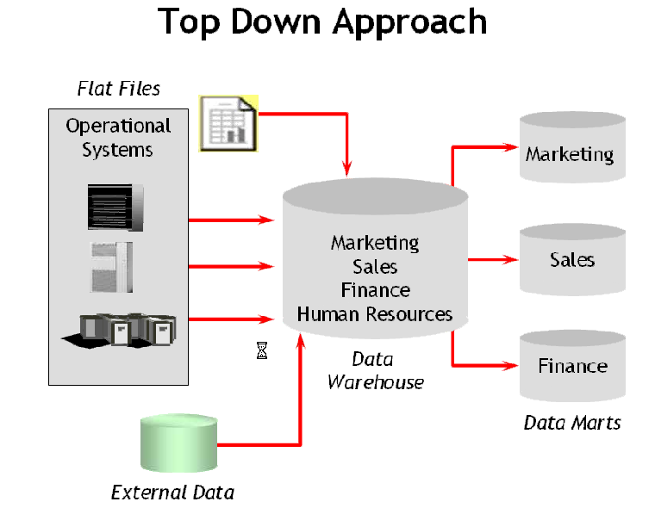
Dependent Data mart or Top Down Approach
Business Intelligence Workflow(4/6)

Slide 12
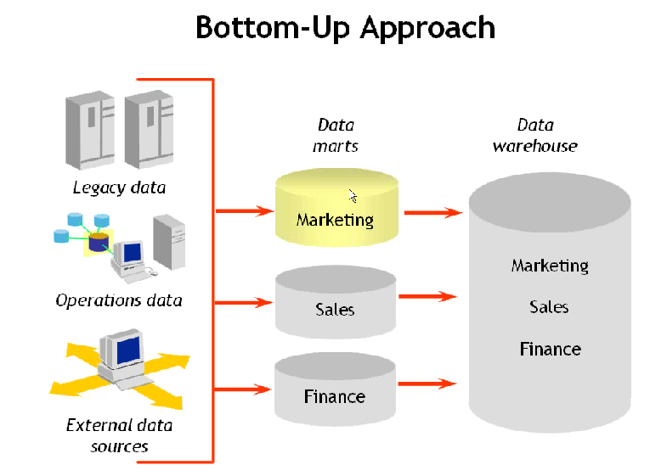
Independent Data mart or Bottom Up Approach
Business Intelligence Workflow(5/6)

Slide 13
Business Intelligence Workflow(6/6)
Data-warehouse Vs. DataMart
Data warehouse
Data
Mart
Property | Data Warehouse | Data Mart
Scope | Enterprise | Department
Subjects | Multiple | Single
Data source | Many | Few
Implementation Time | Months to years | Months

Slide 14
Business Intelligence overview
Business Intelligence workflow
Components of DWH
Meta-Data in DWH
Data warehouse Schemas
Introduction to BI Testing
BI Testing Approach
Introduction to ETL
ETL test processes and scenarios
Introduction to Reporting
Report Testing scenarios

Slide 15
Components of DWH(1/10)
Dimension Table
Dimension tables contain textual information that represents the attributes of the business
Contain relatively static data
Dimension tables are joined to a fact able through foreign key reference
Example: -
PatientKey | PatientID | PatientName | Address | BirthDate | Effective From | Effective to date | Load Date
1 | PI1 | Pansullo | Stradford,TN | 19850505 | 20120101 | 20990101 | 20120101
2 | PI2 | Magnano | NewJersy | 19750304 | 20120101 | 20990101 | 20120101
3 | PI3 | Borreggine | Bluffton,SC | 19890105 | 20120101 | 20150406 | 20120101
4 | PI3 | Borreggine | Franklin,TN | 19890105 | 20150406 | 20990101 | 20120101

Slide 16
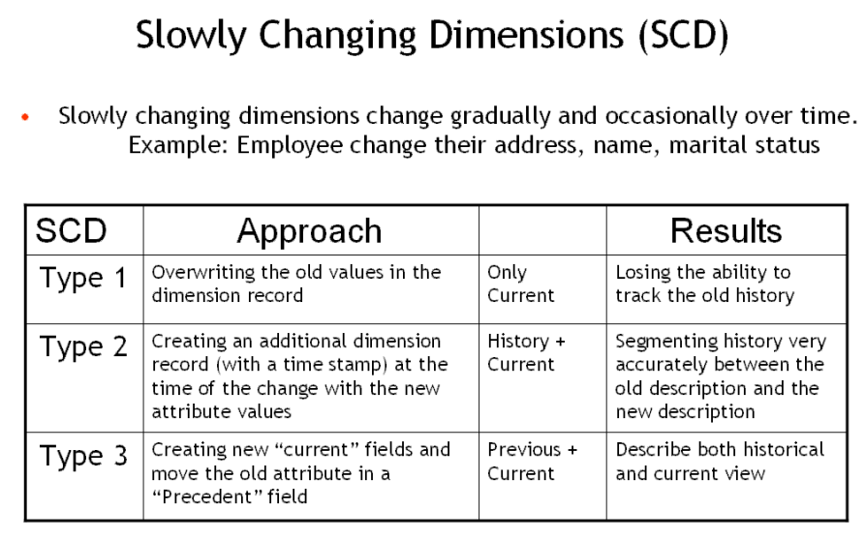
Components of DWH(2/10)
Slowly Changing Dimensions (SCD)
Slowly changing dimensions change gradually and occasionally over time. Example, Employee change their address, name, marital status.

Slide 17
Components of DWH (3/10)
Slowly Changing Dimensions (SCD)
In our example, recall we originally have the following table for e.g.,Customer Dimension,
Customer Key | Name | State
1001 | Christinia | Illinois
After Christina moved from Illinois to California, the new information replaces the new record, and we have the following table as per Type 1 SCD,
Customer Key | Name | State
1001 | Christinia | California

Slide 18
Components of DWH(4/10)
Slowly Changing Dimensions (SCD)
In Type 2, After Christina moved from Illinois to California, we add the new information as a new record into the table:
Customer Key | Name | State | Effective_Start_Date | Effective_End_Date
1001 | Christina | Illinois | 2010-01-01 | 2010-12-01
1001 | Christina | California | 2010-12-02 | NULL
In Type 3, the information gets updated in the same record , and we have the following table,
Customer Key | Name | Original State | Current State | Effective_Start_Date
1001 | Christina | Illinois | California | 2010-12-02

Slide 19
Components of DWH(5/10)
Fact Table
Contain numerical metrics of the business
Can hold large volumes of data
Can grow quickly
Example: -
VISITID | PatientID | DateOFVisit | VisitCharges | WaitTime | DateEntered
1 | PI1 | 2013-08-01 15:34:05.920 | 5 | 37 | 20130801
2 | PI2 | 2013-09-01 15:34:05.921 | 4 | 33 | 20130801
3 | PI3 | 2013-09-01 15:45:05.922 | 7 | 13 | 20130801

Slide 20
Components of DWH(6/10) Types of Facts
Additive: Additive facts are facts that can be summed up through all of the dimensions in the fact table. A sales fact is good example for additive fact.
Semi-Additive: Semi-additive facts are facts that can be summed up for some of the dimensions in the fact table, but not the others. E.g. Daily balances fact can be summed up through the customers dimension but not through the time dimension.
Non-Additive: Non-additive facts are facts that cannot be summed up for any of the dimensions present in the fact table. E.g. Facts which have percentages, ratios calculated.

Slide 21
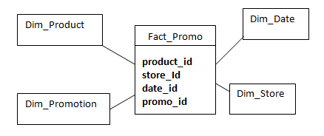
Components of DWH (7/10) Factless Fact Table
In the real world, it is possible to have a fact table that contains no measures or facts. These tables are called “Factless Fact tables”.
E.g: A fact table which has only dimension keys is a factless fact. There are no measures in this table. But still you can get the number products sold over a period of time, store-wise promotions , etc.
Based on the above classifications, fact tables can also be categorized into two:
Cumulative: This type of fact table describes what has happened over a period of time. For example, this fact table may describe the total sales by product by store by day. The facts for this type of fact tables are mostly additive facts.
Snapshot: This type of fact table describes the state of things in a particular instance of time, and usually includes more semi-additive and non-additive facts.

Slide 22
Components of DWH(8/10) Surrogate Keys
Surrogate Key (SK) is sequentially generated meaningless unique number attached with each and every record in a table in any Data Warehouse (DW).
It is UNIQUE since it is sequentially generated integer for each record being inserted in the table.
It is MEANINGLESS since it does not carry any business meaning regarding the record it is attached to in any table.
It is SEQUENTIAL since it is assigned in sequential order as and when new records are created in the table, starting with one and going up to the highest number that is needed.

Slide 23
Components of DWH(9/10)
Attribute:
Attributes represent a single type of information in a dimension.
E.g. year is an attribute in the Time dimension.
A product dimension may be described by its type, category, and brand; a customer may be represented by city and nation. The relationships among the dimensional attributes are expressed by hierarchies.
Hierarchy:
The specification of levels that represents relationship between different attributes within a dimension.
E.g.one possible hierarchy in the Time dimension is Year → Quarter → Month → Day.

Slide 24
Components of DWH(10/10)
Measure:
A measure is a numerical property of a fact and describes a quantitative attribute that is relevant to analysis.
E.g. each sale is measured by the number of units sold, the unit price, and the total receipts.
A measure is normally an additive numerical value that represents a business metric. You can have multiple measures within a fact table.
E.g. if your fact table is used to track purchases internationally you might have measures for each type of currency. If you are building a fact table for the retail industry you might also have the following measures cost, list price, average sale price.

Slide 25
Business Intelligence overview
Business Intelligence workflow
Components of DWH
Meta-Data in DWH
Data warehouse Schemas
Introduction to BI Testing
BI Testing Approach
Introduction to ETL
ETL test processes and scenarios
Introduction to Reporting
Report Testing scenarios

Slide 26
Metadata in DWH(1/2)
Metadata is data that describes other data. Meta is a prefix that in most information technology usages means "an underlying definition or description."
Metadata summarizes basic information about data, which can make finding and working with particular instances of data easier.
For example, author, date created and date modified and file size are examples of very basic document metadata. Having the ability to filter through that metadata makes it much easier for someone to locate a specific document.
Ralph Kimball describes metadata as the DNA of the data warehouse as metadata defines the elements of the DWH and how they work together. Kimball refers to three main categories of metadata: Technical metadata, business metadata and process metadata.

Slide 27
Metadata in DWH(2/2)
Technical metadata
Define the objects and processes in a DW/BI system, as seen from a technical point of view.
The technical metadata include the system metadata which define the data structures such as: tables, fields, data types, indexes and partitions in the relational engine, and databases, dimensions, measures, and data mining models.
Technical metadata define the data model and the way it is displayed for the users, with the reports, schedules, distribution lists and user security rights.
Business metadata
The business metadata tell you what data you have, where they come from, what they mean and what their relationship is to other data in the data warehouse.
Business metadata may also serve as a documentation for the DW/BI system. Users who browse the data warehouse are primarily viewing the business metadata.
Process metadata
Used to describe the results of various operations in the data warehouse.
Within the ETL process, all key data from tasks are logged on execution. This includes start time, end time, CPU seconds used, disk reads, disk writes and rows processed. When troubleshooting the ETL or query process, this sort of data becomes valuable.
Process metadata are the fact measurement when building and using a DW/BI system.

Slide 28
Business Intelligence overview
Business Intelligence workflow
Components of DWH
Meta-Data in DWH
Data warehouse Schemas
Introduction to BI Testing
BI Testing Approach
Introduction to ETL
ETL test processes and scenarios
Introduction to Reporting
Report Testing scenarios

Slide 29
Data warehouse Schemas(1/4)
A schema is a collection of database objects, including tables, views, indexes, and synonyms.
Data Warehouse environment usually transforms the relational data model into some special architectures. There are many schema models designed for data warehousing but the most commonly used are:-
Star Schema
Snowflake Schema
Fact constellation Schema
Galaxy Schema

Slide 30
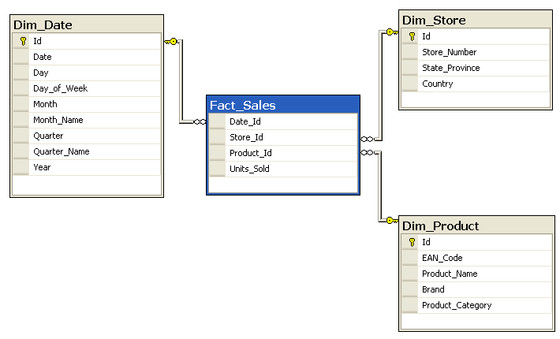
Data warehouse Schemas(2/4) Star Schema

Slide 31
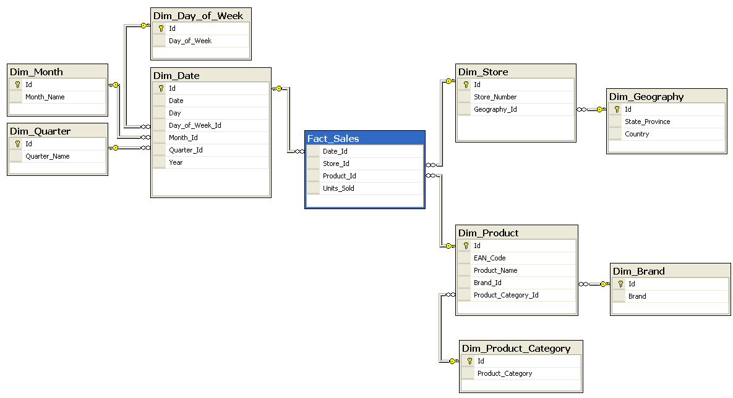
Data warehouse Schemas(3/4) Snowflake Schema

Slide 32
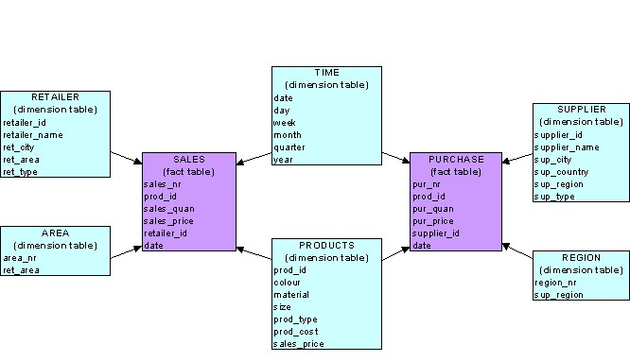
Data warehouse Schemas(4/4 ) Fact Constellation/Galaxy Schema

Slide 33
Business Intelligence overview
Business Intelligence workflow
Components of DWH
Meta-Data in DWH
Data warehouse Schemas
Introduction to BI Testing
BI Testing Approach
Introduction to ETL
ETL test processes and scenarios
Introduction to Reporting
Report Testing scenarios

Slide 34
Introduction to BI Testing(1/3) Basic Skillset of a BI Tester
Knowledge of SQL.
Basic knowledge of UNIX
Understanding of Data warehouse concepts
Knowledge of ETL processes and tool
Knowledge of Reporting tool
Domain knowledge to understand the business needs from a BI perspective. e.g. Finance, Marketing, HealthCare, etc.

Slide 35
Introduction to BI Testing(2/3) Why BI Testing is needed?
Senior Executives in organizations across all sectors relies on data warehouse to make data driven decisions, hence it is important that the data, its flow and its transformation in Business Intelligence Systems is validated carefully and correctly.
Importance
The success of business decisions depends on the quality of underlying information which demands a data-centric test strategy.
It is important to test, authenticate and validate integrated view of the business dimensions to monitor, track and improve business performance.
Due to rapidly changing business environment, decisions may need to be based on near-real time data,. Hence data accuracy also needs to be maintained.
Adapting quickly to market changes and customer requirements and helps in modifying business rules according to the changing conditions without impacting the existing BI Process.

Slide 36
Introduction to BI Testing(3/3) Challenges of BI Testing
BI Testing differs from testing of operational systems on several accounts. The key areas are described in this section below,
CHALLENGES in Business Intelligence Testing
Complex Data Architecture | Multiple, abstract sub-systems Sources Data Integration – Extract, Match, Validate, Cleanse, Complete, Conform Data Structures – Staging, ODS, EDW, Marts Presentation – semantic layer, information delivery
Technologies | Multiple technologies & vendors – RDBMS, ETL, Data Quality, MDM, Metadata Mgmt, Analytics & Reporting
Interfaces | Interactive user interfaces to view data Data processed via backend data feeds
Data & BI Process Centric | BI systems not only need to be tested for validity of data processing as per business rules, but also for robust Data Integration & Reporting processes
High Data Volumes | Extremely high, batch oriented
Multiple Focus Areas | Data processing BI Process Information presentation
Business
Analysis
Organization
Decisions
Impacts
Strategic
Planning

Slide 37
Business Intelligence overview
Business Intelligence workflow
Components of DWH
Meta-Data in DWH
Data warehouse Schemas
Introduction to BI Testing
BI Testing Approach
Introduction to ETL
ETL test processes and scenarios
Introduction to Reporting
Report Testing scenarios

Slide 38
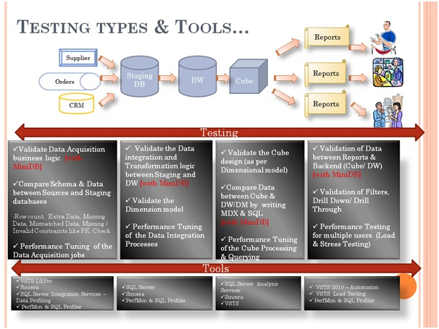
BI Testing Approach(1/2)
The success of any Data Warehouse (DWH) solution lies in its ability to not only analyse huge amounts of data over time but also to provide stakeholders and end-users meaningful options that are based on real-time data. A good DWH test strategy should also cover validation of loading of all required rows, correct execution of all transformations and successful completion of the cleansing operation.

Slide 39
BI Testing Approach(2/2)
The focus of Data Warehouse test strategy is primarily on four key aspects:
Data Quality validation
This is core to any data warehouse tests and includes tests for data completeness, data transformation and data quality.
End user & BI / report testing
Extreme care should be taken while testing and the reports should be as clear and self-explanatory as possible. Usability, performance, data accuracy and preview and/or export to different formats are areas where most of the failures occur.
Load and Performance testing
With increasing volume of data, stability and scalability become critical test parameters. Under stress from large transactional data volumes, data warehouses will typically not scale, and eventually fail, unless they are tested and issues are fixed. To avoid such problems, it is essential that the test team design and execute series of tests that validate the performance and scalability of the system under different loads.
End-to-End (E2E) regression and integration testing
Integration tests show how the application fits into the overall flow of all upstream and downstream applications.
Notes:
Data Quality Validation: An essential part of the overall ETL test strategy is validating data for accuracy, which is core to any Data Warehouse tests. Validating data for quality includes test for data completeness, data transformation and data quality. » Data Completeness Tests: are designed to verify that all the expected data loads into the data warehouse. This includes running detailed tests to verify that all records are completely loaded without errors in content quality or quantity.
» Data Transformation Tests: are designed to verify the accuracy of the transformation logic or transformation business rules. This can, at times, be a complex activity hence teams should consider using automated tools as part of the test strategy. Integration tests are generally a part of data transformation tests. This is covered in more detail in a separate section below.
» Data Quality Tests: are designed to validate system behavior when data is rejected (example: data inaccuracy or missing data) during data correction and substitution. Scenario-based tests and Validation tests for the solution's reporting feature are part of Data Quality Tests.
End User and BI / Report Testing: Testing for accuracy of reports is another critical aspect in Data warehouse testing. Extreme care should be taken while testing, as reports are probably the only experience most users have with the Data Warehouse and Business Intelligence (DW/BI) system. The guiding philosophy is that testing reports should be as clear and self-explanatory as possible. Usability, performance, data accuracy and preview and/or export to different formats are areas where most of the failures occur. » Data display on the business views and dashboard are as expected
» Users can see reports according to their user profile (authentication and authorization)
» Verification of Report format and content by appropriate end users
» Verification on the Accuracy and completeness of the scheduled reports
» OLAP, Drill down report, cross tab report, parent / child report etc are all working as expected
» 'Analysis Functions' and 'Data Analysis' are working
» No pilferage of data between the source systems and the views
» Testing of Replicated reports from old system to new system for consistency of business rules
» Previewing and/or exporting of reports to different formats such as spreadsheet, pdf, html, e-mail displays accurate and consistent data
» Print facility, where applicable, produces expected output
» Where graphs and data in tabular format exist, both should reflect consistent data
Load and Performance Testing: With increasing volume of data, stability and scalability become critical test parameters. Under stress from large transactional data volumes, data warehouses will typically not scale, and eventually fail, unless they are tested and issues are fixed. To avoid such problems, it is essential that the test team design and execute series of tests that validate the performance and scalability of the system under different loads. As part of this activity, the following tests can be executed: » Shutdown the server during batch process and validate the result
» Perform ETL with load that is twice or thrice the maximum possible imagined data (for which the capacity is planned)
» Run huge volumes of ad-hoc queries mimicked from multiple users simultaneously
» Run large number of scheduled reports
» Monitor the timing of the reject processes and check system behavior when handling large volumes of rejected data
E2E Integration and Regression Testing: Integration tests show how the application fits into the overall flow of all upstream and downstream applications. When designing Integration Tests, the focus of the tester should be on the following topics: » How the overall process can break and focus on the integrations between different systems and their subsystems
» Validating system behavior when different types of data (different user profiles, different data types, different data volumes etc) get processed and communication to the subsequent system
» Run custom-designed regression tests that simulate end user behavior (ensures success of user-acceptance tests)

Slide 40
Business Intelligence overview
Business Intelligence workflow
Components of DWH
Meta-Data in DWH
Data warehouse Schemas
Introduction to BI Testing
BI Testing Approach
Introduction to ETL
ETL test processes and scenarios
Introduction to Reporting
Report Testing scenarios

Slide 41
Introduction to ETL(1/6)
It is a process of Extracting the relevant business information, Transforming the data into a required business format and Loading Into the Data Warehouse.
It is defined with the following processes,
Data Extraction
Data Transformation
Data Loading

Slide 42
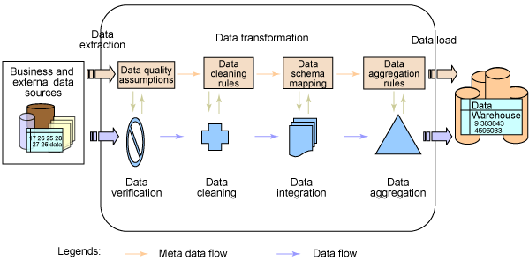
Introduction to ETL(2/6) ETL Process Flow

Slide 43
Introduction to ETL(3/6) Data Extraction
It is a process of reading the data from various types of sources such as relational sources, ERP sources, Mainframe sources, XML file and Flat files.
Relational
Oracle, SQL Server,
ERP
SAP, PeopleSoft
Mainframe
COBOL Files, DB2
File
Flat Files (Text Files), XML Files

Slide 44
Introduction to ETL(4/6) Data Transformation
It is a process of cleaning the data and transforming the data into a required business format. The following data transformation activities take place in staging area,
Data Merging: It is a process of combining the data from multiple inputs and load into a single output. There are two types of Data Merging Activities.
1. Join
2. Union
Data Cleansing:
It is a process of removing unwanted data from Staging
OR
It is a process of changing inconsistencies and inaccuracies
Example : Init Cap() and Round() functions
Data Scrubbing: It is a process of deriving new data definitions using existing data.
Example: Concat (First Name+ Last Name), Sal Amount=QTY*Price
Data Aggregation: It’s process of calculating the summaries for a group of records
Using aggregate functions.
Example : Average, Max, Min etc….

Slide 45
Introduction to ETL(5/6) Data Loading
It is a process of inserting the data into a target system. There are 2 types of Data Loads,
Initial or Full Load
Incremental or Delta Load
1. Initial or Full Load
It is a process of loading all the required data at very first load.
2. Incremental or Delta Load
It is a process of loading only new records after initial load.

Slide 46
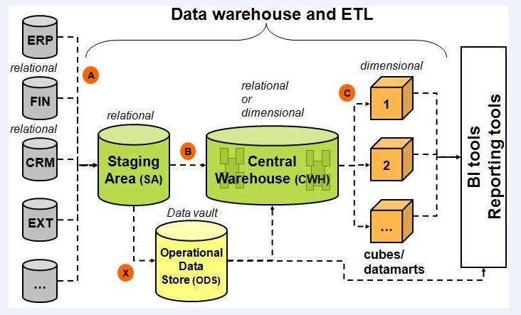
Introduction to ETL(6/6) Operational Data Store
An operational data store (or "ODS") is a database designed to integrate data from multiple sources for additional operations on the data.
Operational data stores exist to support daily operations. The ODS data is cleaned and validated, but it is not historically deep, it may be just the data for the current day.
Rather than support the historically rich queries that a data warehouse can handle, the ODS gives data warehouses a place to get access to the most current data, which has not yet been loaded into the data warehouse. The ODS may also be used as a source to load the data warehouse

Slide 47
Business Intelligence overview
Business Intelligence workflow
Components of DWH
Meta-Data in DWH
Data warehouse Schemas
Basic Skill set for BI tester
Why BI testing is needed
Challenges of BI Testing
BI Testing Approach
Introduction to ETL
ETL test processes and scenarios
Introduction to Reporting
Report Testing scenarios

Slide 48
ETL Test Process(1/3) Data extraction
Purpose
To show that all source data, for every data specification, with all known data errors will be handled correctly.
Scope
All data extraction programs – to be tested on samples of all source data files
Prerequisites
Source data have been tested, have been analyzed
Techniques and requirements
Test extraction for every source file
Test extraction for every source / domain specification
Check extraction for every data item
Test every data item on boundary values, hard coded values
Test all validation output
Test all counters and totaling options

Slide 49
ETL Test Process(2/3) Data Transformation
Purpose
To show that all data transformation rules are implemented and do function as specified.
Scope
All data transformation programs - to be tested against all transformation rules / specifications.
Prerequisites
Source data have been tested, have been analyzed
Techniques and requirements
Standard techniques to be applied for black box unit test
Covering all data transformation rules - as there are
Coding and decoding of data values
Consolidation of data records, production of totals
Addition of linked data items

Slide 50
ETL Test Process(3/3) Data Loading
Purpose
To show that all data loading (in the data warehouse) will function undisturbed - without errors, performing as required
Scope
From (final) staging area to data warehouse itself.
Prerequisites
Staging area data are available - in full size - preferable with more than one increment, in order to test for linearity
We’ll require performance requirements in full
Techniques and requirements
Performance testing techniques and analysis tools to be used

Slide 51
Business Intelligence overview
Business Intelligence workflow
Components of DWH
Meta-Data in DWH
Data warehouse Schemas
Introduction to BI Testing
BI Testing Approach
Introduction to ETL
ETL test processes and scenarios
Introduction to Reporting
Report Testing scenarios

Slide 52
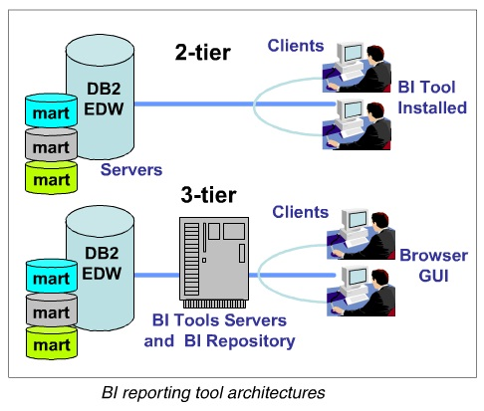
Introduction to Reporting(1/3) BI Reporting Tool Architecture
The different data analysis tools for reporting typically fall into two main architectures,
2-tier: In this architecture, the BI reporting tool is installed on the client machines and these tools (clients) directly access the data warehouse or the data marts.
3-tier: In this architecture, the BI reporting server software is installed on a server machine. All the clients access the data warehouse or the data marts by using a browser. No special tool must be installed on the clients

Slide 53
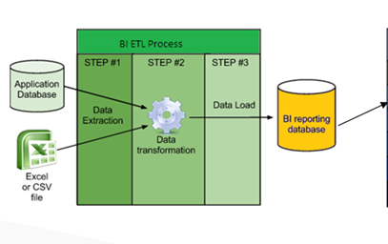
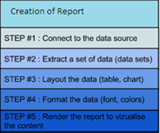
Introduction to Reporting(2/3) Reporting Process

Slide 54
Introduction to Reporting(3/3) Reporting Process
Query analysis and reporting are the processes for posing questions to answer, retrieving relevant data from the data warehouse, transforming it into the appropriate context, and displaying it in a readable format.
For example, you might ask, "How much of that product has been sold this week?" When the query is executed, the tool generates the appropriate language commands to access and retrieve the requested data from a retail data warehouse.
The data analyst then performs the required calculations and manipulations on the answer set to achieve the desired results. Those results are then formatted to fit into a display or report template that has been selected for ease of understanding by the user.
This template could consist of combinations of text, graphic images, video, and audio.
Finally, the report is generated with various metrics such as sales of a given product, customer satisfaction rates, delays in the business processes, and late or wrong shipments etc.
Users may need to analyze the effects of business transactions or events, analyze trends, or extrapolate their predictions for the future with the help of such reports.
Often the data displayed will cause the user to formulate another query to clarify the answer set or gather more detailed information. This process continues until the desired results are reached.

Slide 55
Business Intelligence overview
Business Intelligence workflow
Components of DWH
Meta-Data in DWH
Data warehouse Schemas
Basic Skill set for BI tester
Why BI testing is needed
Challenges of BI Testing
BI Testing Approach
Introduction to ETL
ETL test processes and scenarios
Introduction to Reporting
Report Testing scenarios

Slide 56
Report Testing scenarios(1/4)
Below are the different aspects related to BI Reporting that should be considered while testing –
Prompts/Filters/Selection Criteria
Type of prompt
Description of prompt
Default selection
Values in prompt
Minimum and Maximum selection
Mandatory prompts
Report
Label and Headings
Layout and Graphs
Measures/Metrics
Correctness of Data
Paging and sorting
Drilling
Export

Slide 57
Report Testing scenarios(2/4) Prompts/Filters/Selection Criteria
Type of prompt: List/Drop Down/Check Box/Text Field/Date Selector are different kind of prompts that are used in reports
Description of prompt: Describes the purpose of the Prompt.
E.g. “Select the date from the calendar for which you want to view the report” can be a description to describe date filter
Default selection: A default value that will be always be selected before the report is run. This value can be hardcoded or based on Algorithm
E.g. Date prompt displaying previous date by default
Values in prompt: Single/Multiple values can be selected from a prompt. If the list of values are huge , it can even be searched by typing the correspondence text in prompt.
E.g. User wish to select multiple cities from the prompt
Minimum and Maximum selection : This type of prompt are usually used when we set a lower and upper limit.
E.g. Eligibility criteria where lower limit is set as 18 and upper limit is set as 60
Mandatory prompts: There are many reports that fetches huge data from database. So to reduce the amount of result and increase the usability of that report mandatory filters are set.
E.g. For report that fetches years of data, date filter is mandatory

Slide 58
Report Testing scenarios(3/4) Reports
Labels and Headings : Labels and headings helps in making the reports more user friendly. While testing the Report it is important to check whether the correct label/Heading is displayed.
Layout and Graphs : A report layout consists of three main areas: a page header, page footer, and the body. The header and footer can stay constant across all the reports. The body of the report contains the report data. Graph is a diagrammatical representation of data. Testing includes whether the graphs and layout are created as per requirement
Measures/Metrics : Measures and Metrics consists of data that is fetched from the database. These can be directly fetched from the database or can be calculated at report level.
E.g. Services Provided can be a direct measure and Percentage of service provided in Rural area can be calculated one

Slide 59
Report Testing scenarios(4/4) Reports
Correctness of Data : This is one of the key point in testing where in validation of data is done. This can be done by validating the data with database using SQL or comparing it with other report.
Paging and sorting : Paging can be set when there are huge no of records in a report and sorting is done when User wants to view some records in a particular order.
E.g. User wants to view employee details in alphabetical order
Drilling : It is an important Functionality in report testing. Using this functionality , uer can drill down the report at lower level or drill it up to see the summarized results
E.g. A User views a report at year level and wants view it at half year, Quarter, Month, Week and day level. In this case Drill down functionality can be implemented
Export : There are different formats in which Report can be extracted.
E.g. CSV,PDF,EXCEL,ETC

Slide 60


Questions

Slide 61

Thank You

